Slide 1
Crime Prediction and Analysis in South Africa
Thendo Manthada

Slide 2
Table of Content
Executive Summary
Introduction
Methodology
Results
Conclusion
Appendix

Slide 3
Executive Summary
The aim of this project is to make crime prediction using the features present in the dataset. The dataset is extracted from the official sites. With the help of machine learning, using python as core we can predict the type of crime which will occur in a particular area.
The objective would be to train a model for prediction. The training would be done using the training data set which will be validated using the test dataset. Building the model will be done using better algorithm depending upon the accuracy. The K-Nearest Neighbor (KNN) classification and other algorithm will be used for crime prediction.
Visualization of dataset is done to analyze the crimes which may have occurred in the country. This work will help the law enforcement agencies to predict and detect crimes in South Africa with improved accuracy and thus reduces the crime rate.

Slide 4
Introduction
Crime is deﬁned as any harmful act against the public which the State wishes to
prevent and which, upon conviction, is punishable by ﬁne, imprisonment, and/or death.
Historically solving crimes has been the privilege of legal enforcement specialists.
But lately computer analysts have aided the legal enforcement in solving crimes by
discovering crime patterns. Crime rate is affected by number of Economic factors such
as Income level, unemployment rate and Gross Domestic Product (GDP), Consumer
Price Index (CPI) etc.
An economic crisis is a situation where the economy of a country experiences a
sudden downturn as a result of ﬁnancial crisis. Whether there is economic crisis or
not, the economic indicators like unemployment have a direct impact on the South African
population and thus affect crime rates. Due to ﬁnancial crisis, there is an increase
in unemployment and large number of population suffers sudden reduction in their
income.

Slide 5

Methodology

Slide 6
Methodology
Data collection methodology:
Perform data wrangling
Perform exploratory data analysis (EDA) using visualization and SQL
Perform interactive visual analytics using Folium and Plotly Dash
Perform predictive analysis using classification models

Slide 7
Data collection & Data wrangling
Data Collection
Crime dataset from South African statistic (StatsSA) is used in CSV format.
Crime dataset from South African Police services is used in CSV format indicating the number of crimes reported across the country in various police stations
Crime dataset from South African Police services is used in CSV format indicating the number of crimes categories across the country.
Data wrangling
Data was 1st captured into an excel spreadsheet and then converted to csv files.
Removed any missing values present in the dataset
The dataset consists of a 3 Data frames with multiple columns .
The final dataset contains 32,9 & 30 rows which speaks to 9Provinces.
Data Gathering
Data cleaning and Structuring
Predictive Analysis

Slide 8
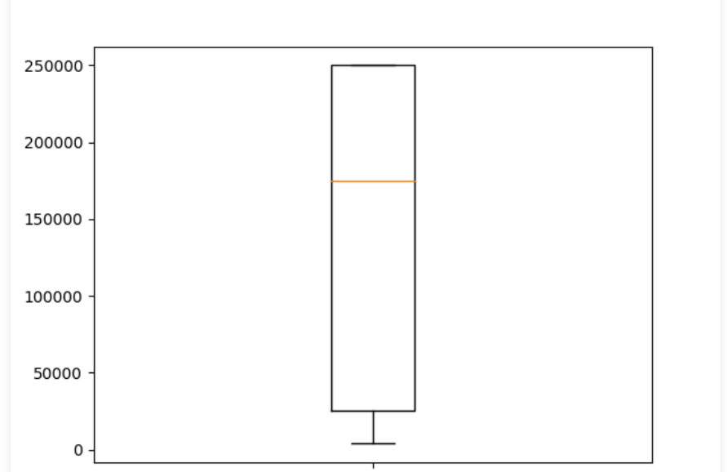
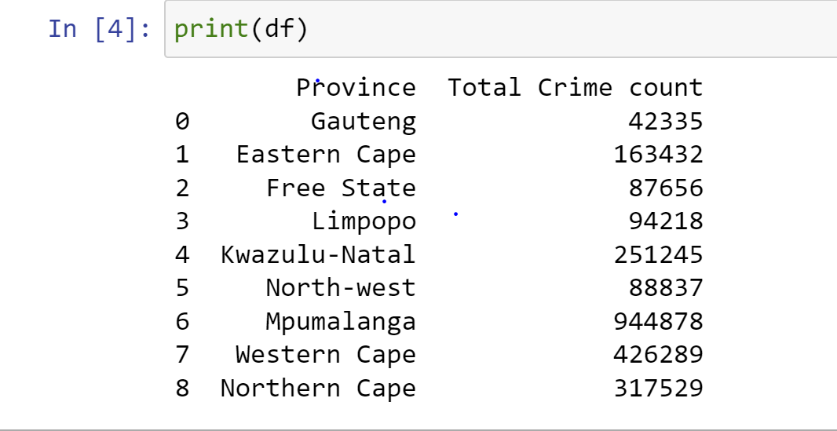
Exploratory data analysis (EDA) using visualization
EDA with Data Visualization

Slide 9
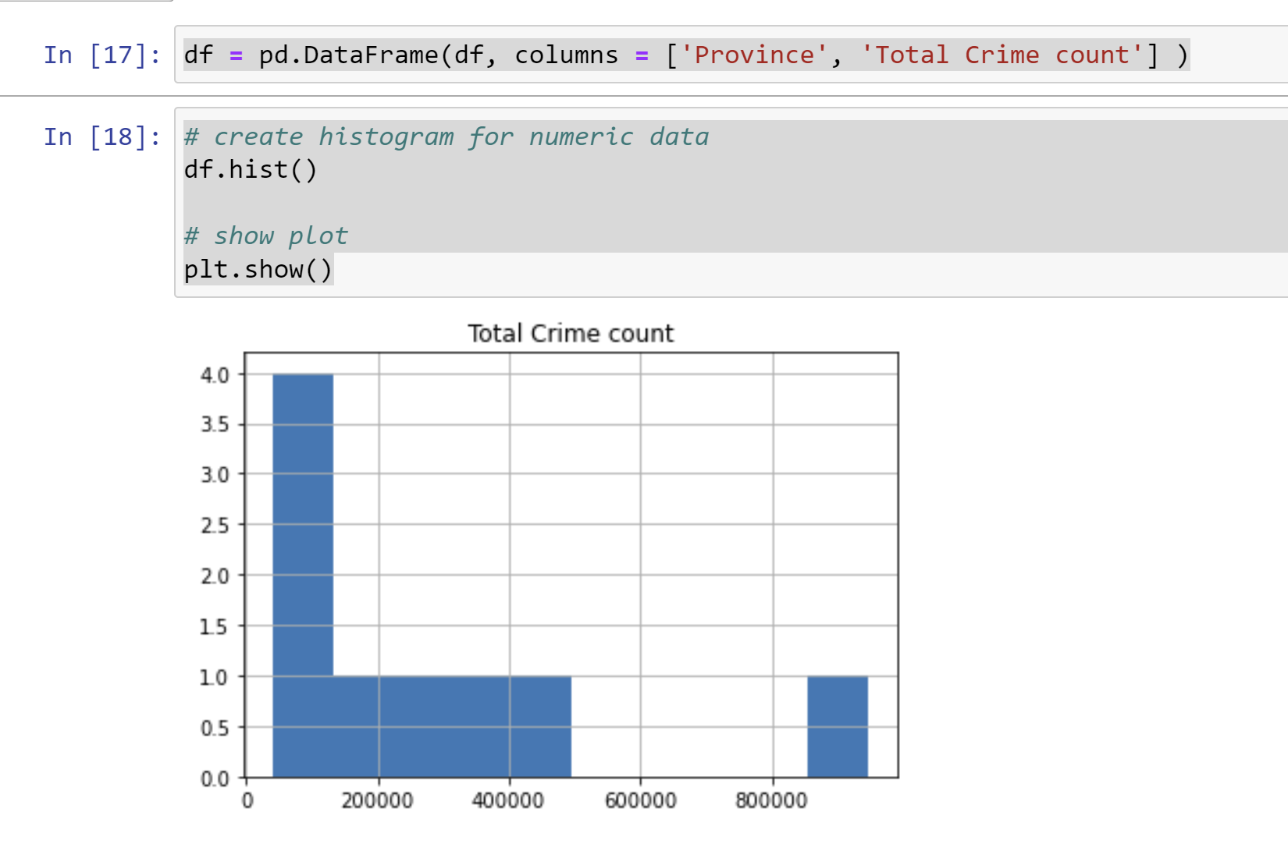
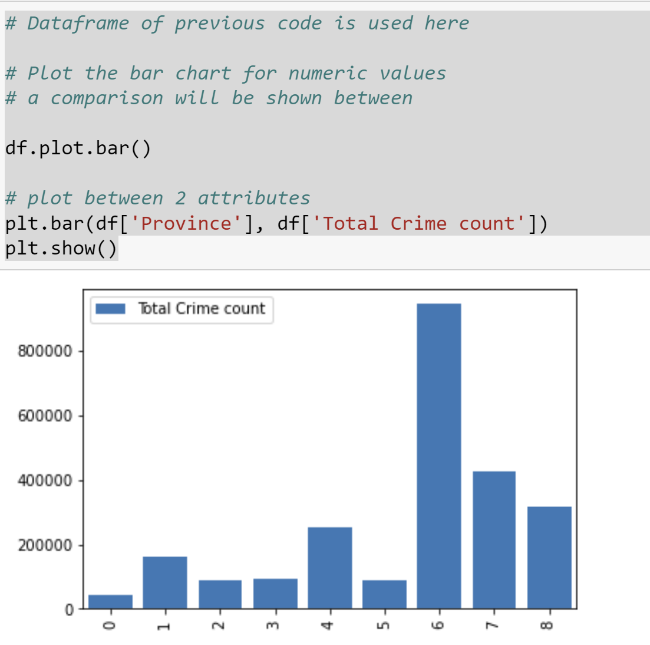
Exploratory data analysis (EDA) using visualization
EDA with Data Visualization
The below graph show the total number of crime committed ,a python code was used in order to plot the graphs accordingly

Slide 10
Exploratory data analysis (EDA) using SQL
Summary of SQL Analysis performed
Total number of crimes per province across the country
Total number of crimes reported in different police stations across years
Total number of crimes per categories across various years
Provinces (Areas)with the highest crimes

Slide 11
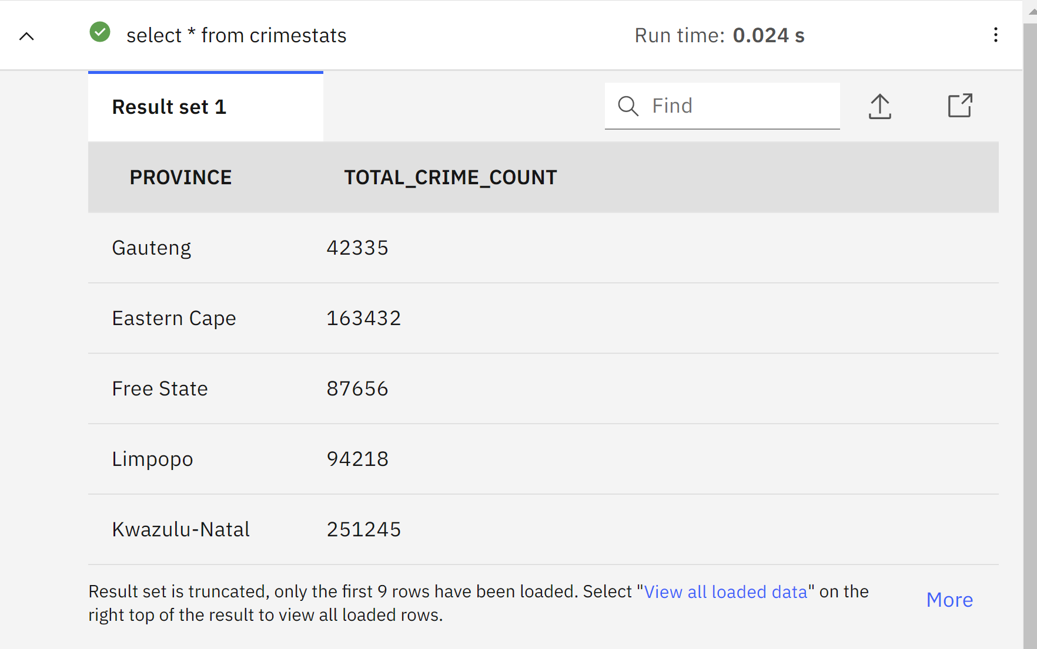
Exploratory data analysis (EDA) using SQL
The Sql table below show the total number of crimes per province across the country

Slide 12
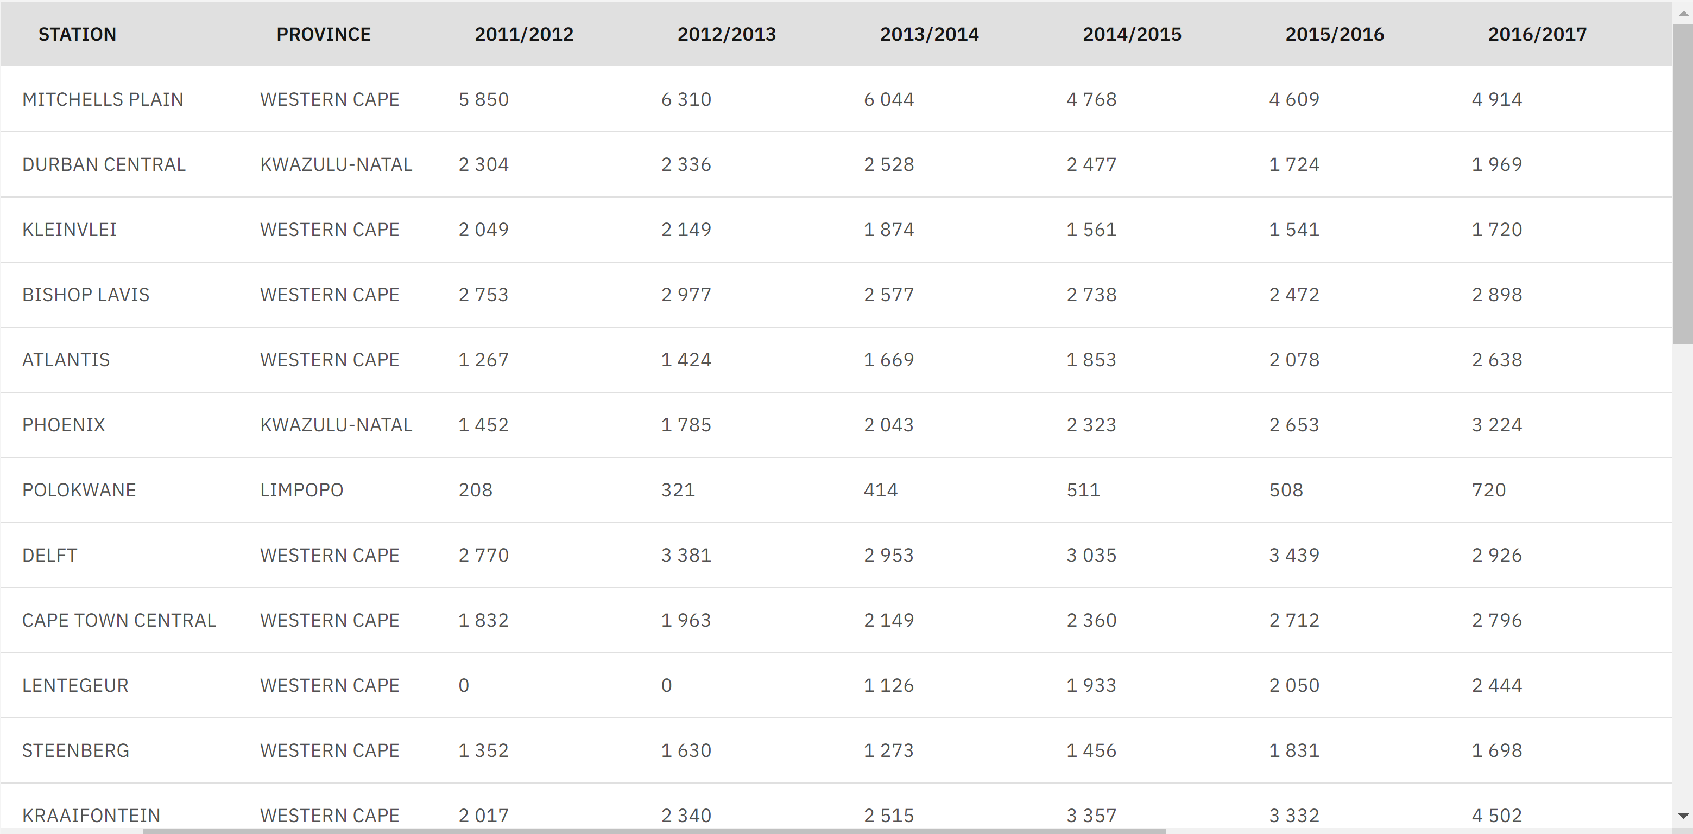
Exploratory data analysis (EDA) using SQL
The Sql table below show the total number of crimes reported in different police stations across many years

Slide 13
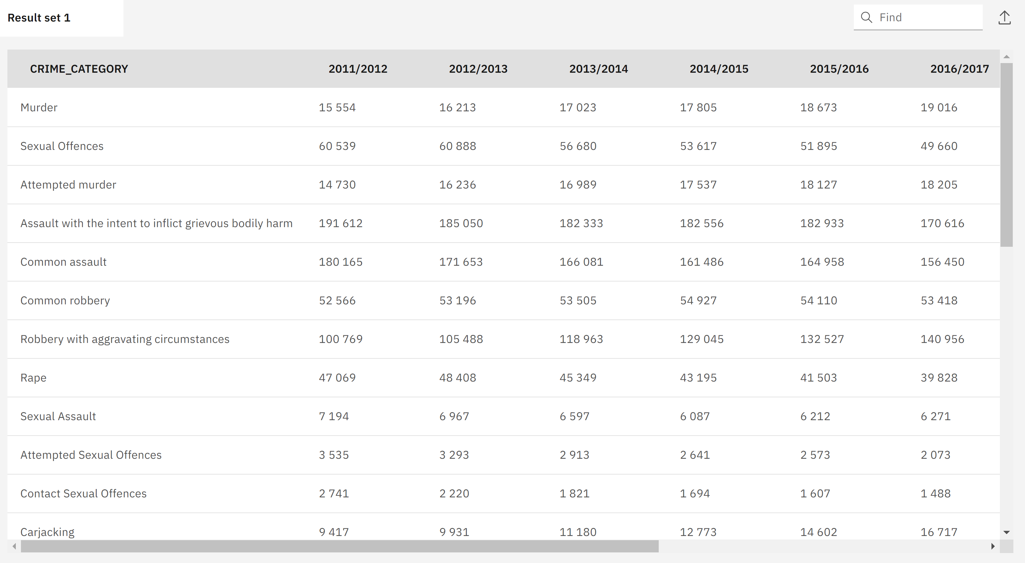
Exploratory data analysis (EDA) using SQL
The Sql table below show the total number of crimes per categories across various years

Slide 14
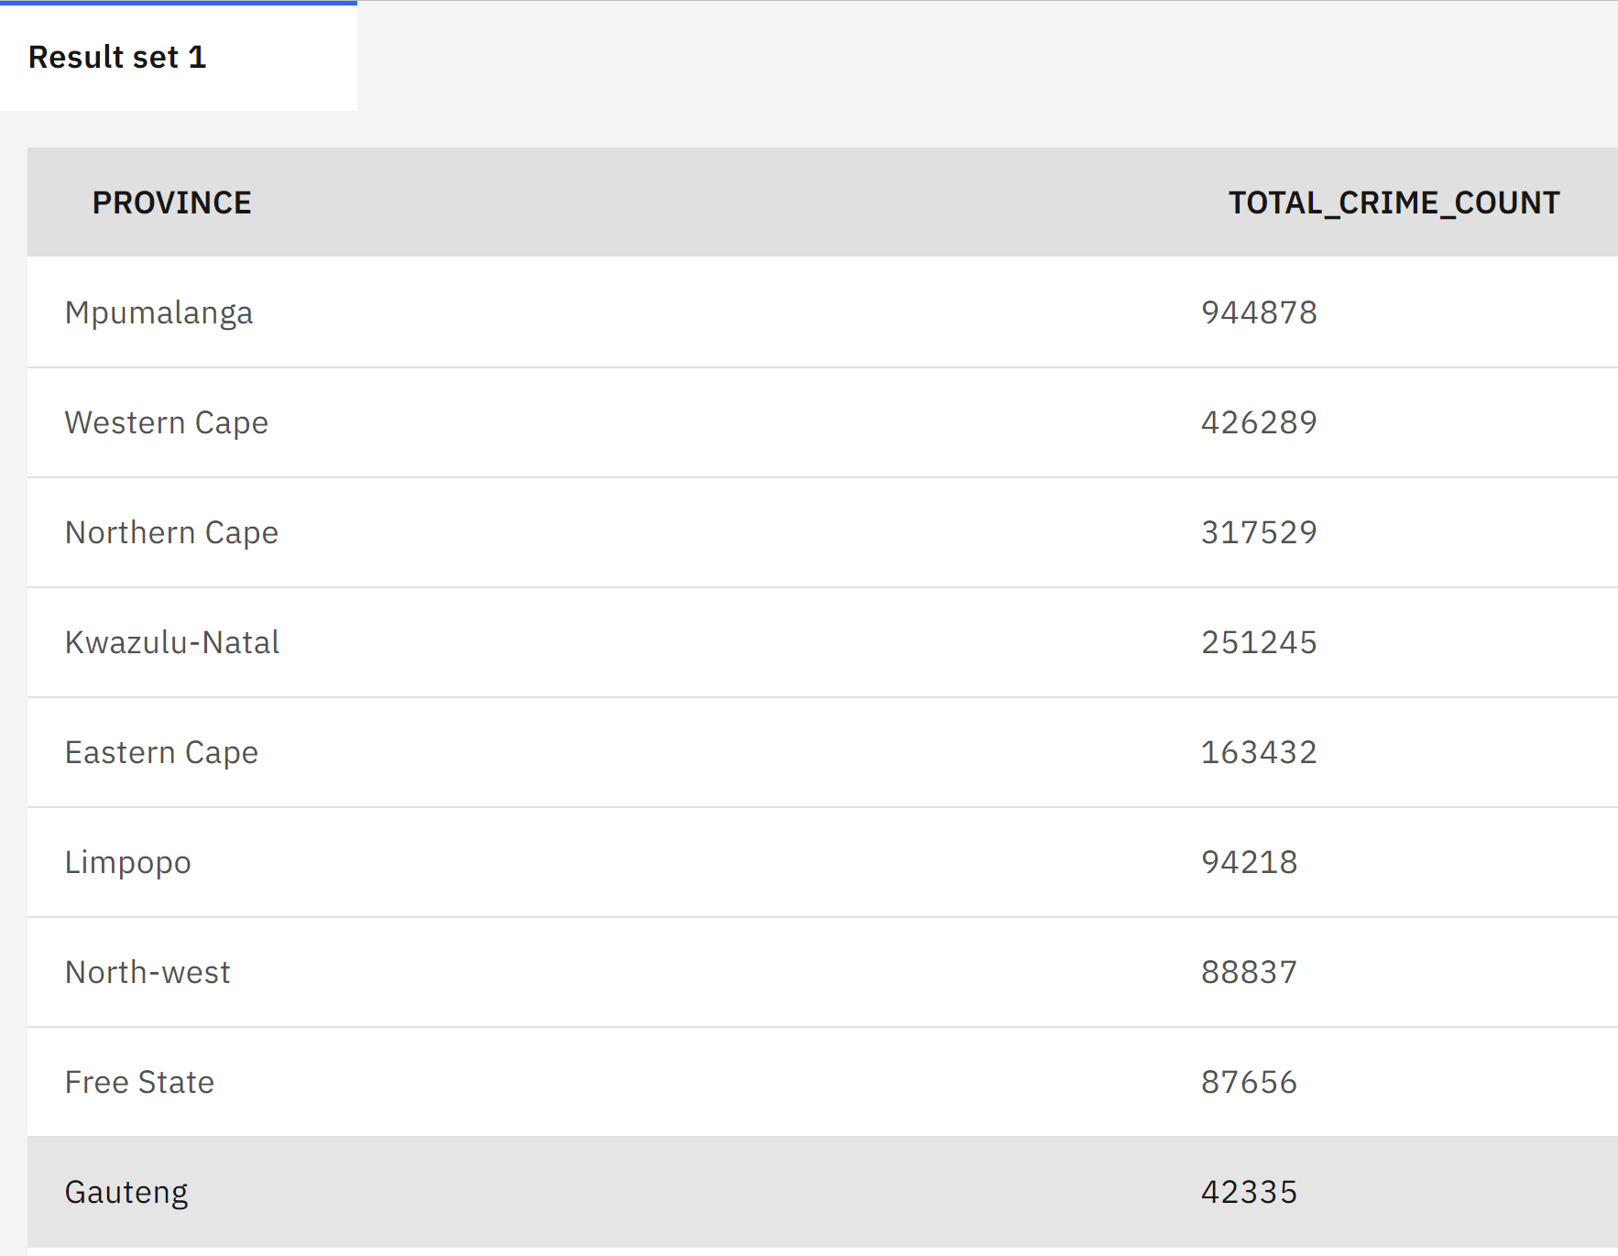
Exploratory data analysis (EDA) using SQL
The Sql table below shows provinces (Areas)with the highest crimes

Slide 15

Interactive visual analytics using Folium and Plotly Dash
This part deals with the analysis done on the dataset and plotting them into various graphs like bar, scatter, Folium and plotly.
Analysis done are
Types of crimes committed over Time (Month).
Types of crimes committed over Time ( Hour).
No of crimes of all types of crime over various location.

Slide 16
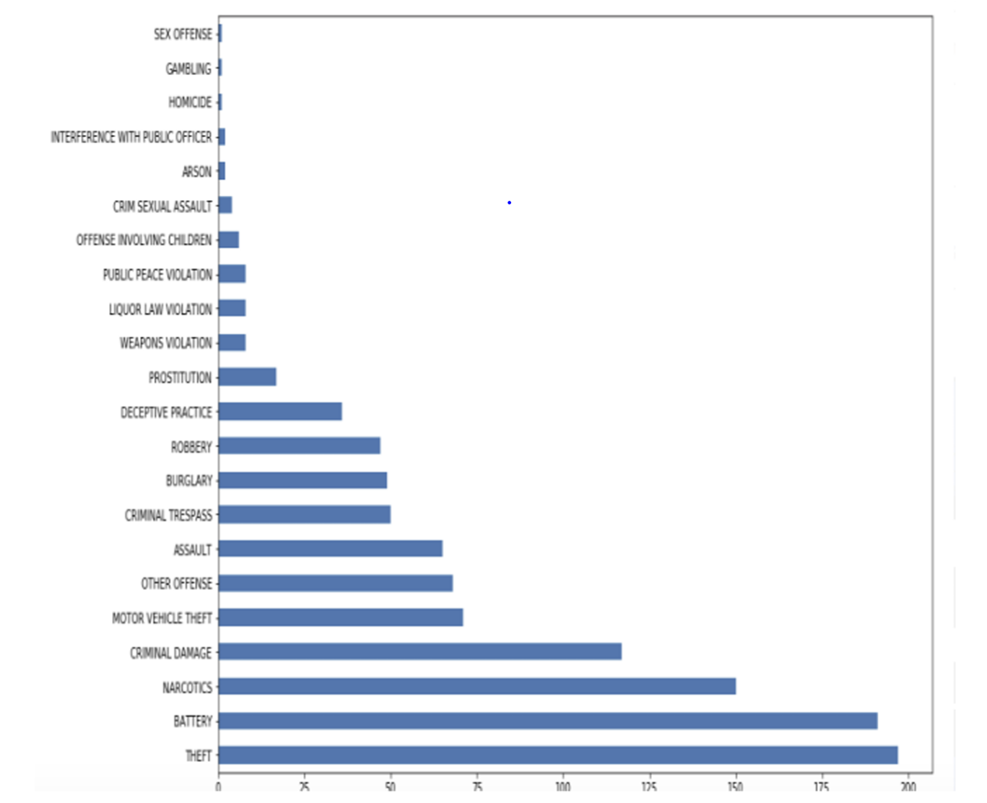
Interactive visual analytics using Folium and Plotly Dash
This graph shows which crimes have occurred most in the city. The y coordinate denotes the Types of crimes committed and x coordinate denotes the no of crimes committed. The highest being Theft.

Slide 17
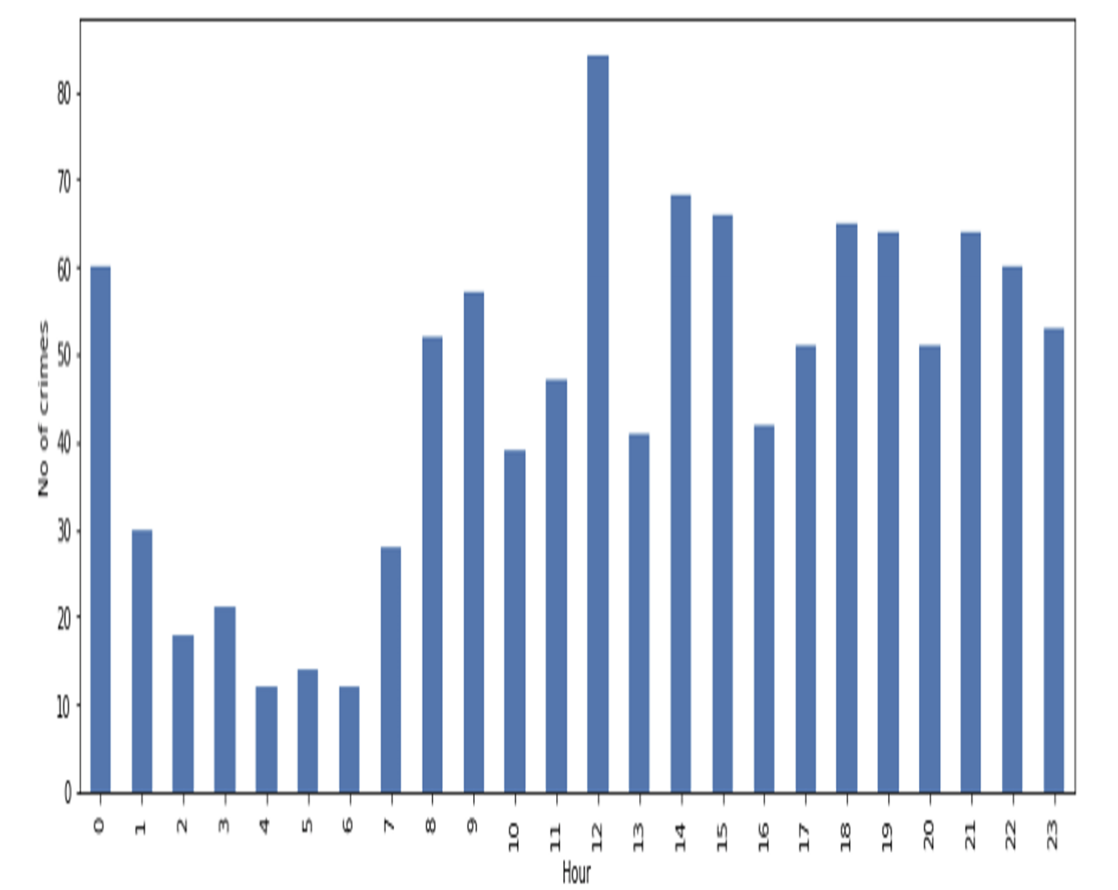
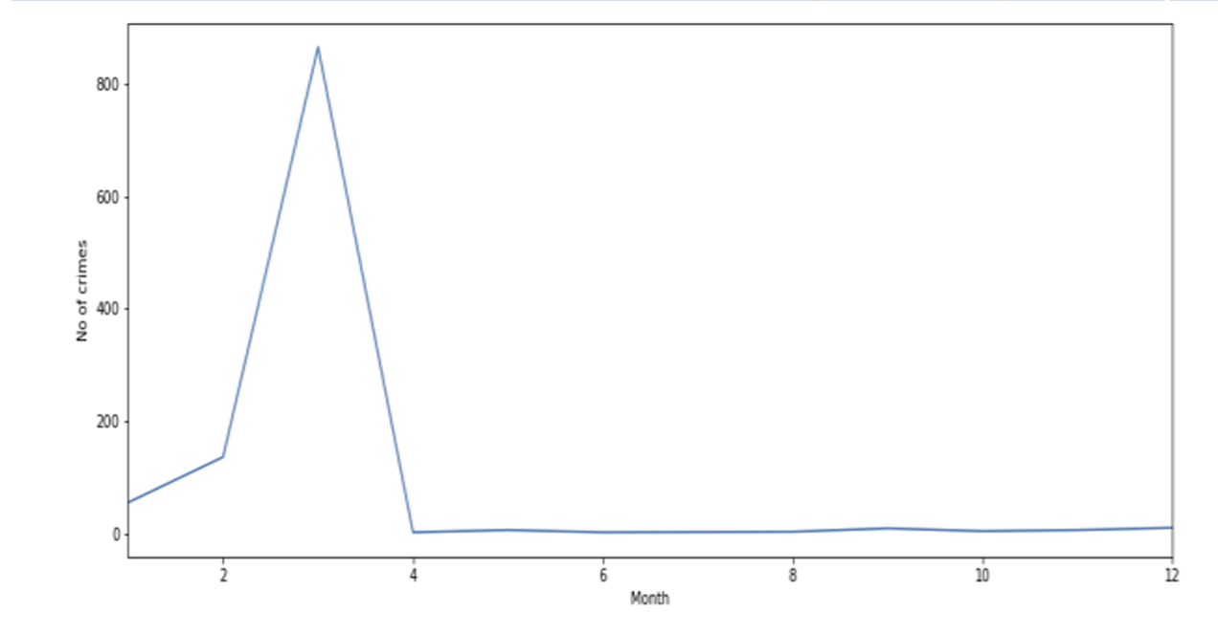
Interactive visual analytics using Folium and Plotly Dash
The graph below tells us about in which month occurrence of crimes is highest. As we can see the month of march is peak where rate of occurrence is high. The x coordinate denotes the month and y coordinated denotes the crime rate.
And also shows crime occurrence over particular hour. The x axis is hour and y axis is rate of crimes

Slide 18
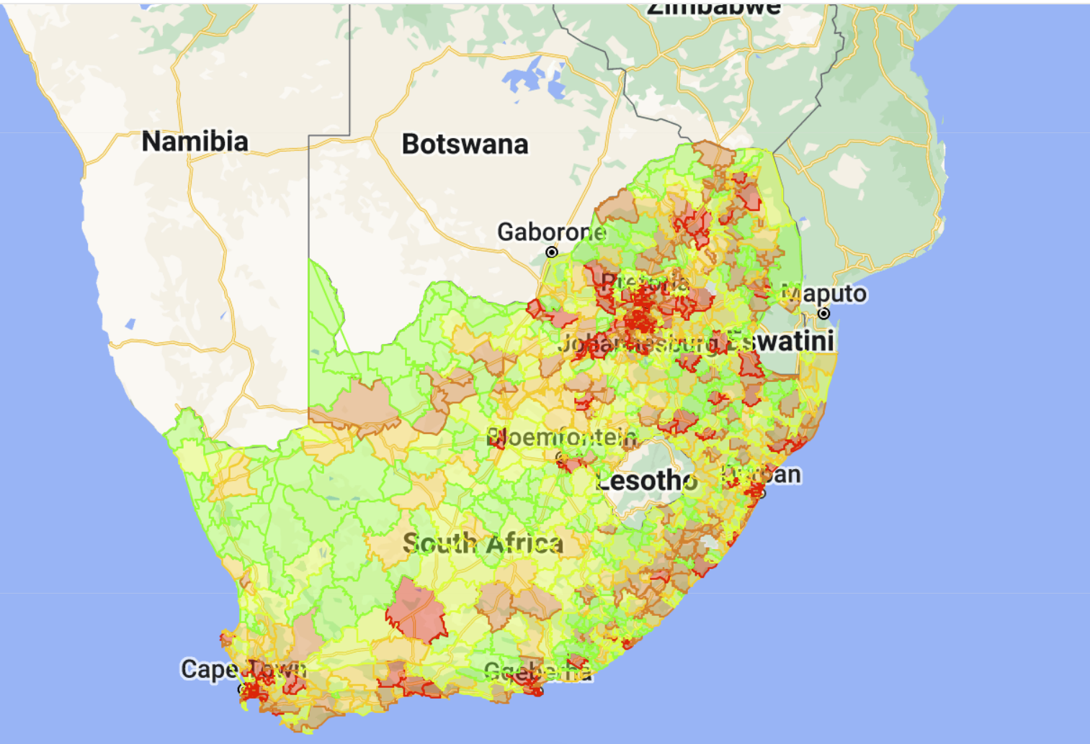
Interactive visual analytics using Folium
This graph shows which crimes have occurred most in the city. The y coordinate denotes the Types of crimes committed and x coordinate denotes the no of crimes committed.

Slide 19
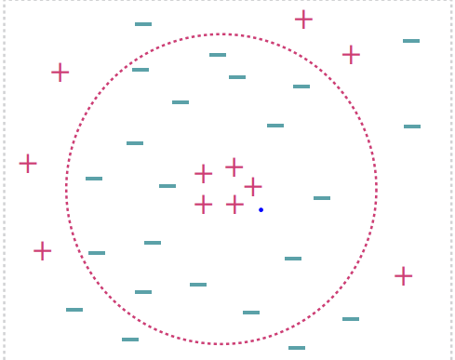
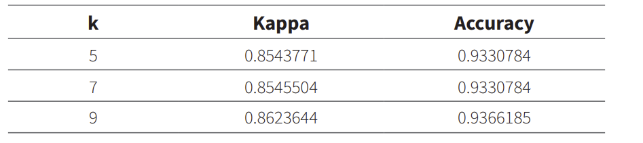
Predictive Analysis using classification models
The k-NN k- Nearest Neighbor classifier (k-NN) is a classification algorithm which was used in this assessment ,modeling procedure of the training data until it is necessary to be labelled and classified.
Data points that a located far from the neighbourhood
Accuracy was calculated so as to assist in choosing the optimal model by means of the largest value and here the final value k=9 was selected for the model.

Slide 20
Results
This machine-learning-based crime analysis involves the collection of data, data classification, identification of patterns, prediction, and visualization. K-nearest neighbor (KNN) and boosted decision tree algorithms were also implemented to analyze the crime dataset. In the study, a total of 322,000 crime datasets between 2011 and 2021 were analyzed, and crime prediction with an accuracy of between 85% and 93% was obtained by predicting the crime using ML algorithms.

Slide 21
Conclusion
The whole analysis assessment indicated the areas of high crime and the stations with the most reported crime across the country, which can easily show the police which area need more attention in terms of more police work and resources needed for the police to do their work, including education on crime and the consequences there off.
ML predictions show the crimes that are most likely to happen which can help in preventing or minimizing such crime.

Slide 22
Reference
Crime Stats SA
Crime forecasting: a machine learning and computer vision approach to crime prediction and prevention | Visual Computing for Industry, Biomedicine, and Art | Full Text (springeropen.com)
extension://elhekieabhbkpmcefcoobjddigjcaadp/https://www.ajhtl.com/uploads/7/1/6/3/7163688/article_25_9_3_372-381.pdf
The impact of crime on inbound tourism to South Africa: An application of the bounds test: African Security Review: Vol 22, No 1 (tandfonline.com)
The Impact of Crime on International Tourist Numbers to Cape Town | SpringerLink
Latest crime statistics: Murder, kidnapping and commercial crimes increase - The Mail & Guardian (mg.co.za)

